Slide 1
Representing and Mining Text
Data Science for Business - Chapter 10
Presented by: Salma Elshahawy
Class: DATA 607 - CUNY
Rpubs: http://rpubs.com/salmaeng/pres_1_607

Slide 2
Why Text is difficult?
Text is “unstructured”
Linguistic structure is intended for human communication and not computers
Word order matters sometimes
Text can be dirty.
Context matters

Slide 3
Text Representation
Goal: Take a set of documents –each of which is a relatively free form
sequence of words– and turn it into our familiar feature-vector form
A collection of documents is called a corpus
A document is composed of individual tokens or terms
Each document is one instance
but we don’t know in advance what the features will be

Slide 4
What is “Bag of Words”?
Treat every document as just a collection of individual words
Ignore grammar, word order, sentence structure, and (usually)punctuation
Treat every word in a document as a potentially important keyword of the document
What will be the feature’s value in a given document?
Each document is represented by a one (if the token is present in the document) or a zero (the token is not present in the document)
Straightforward representation
Inexpensive to generate
Tends to work well for many tasks
Notes:
Bag of Words (BoW) refers to the representation of text which describes the presence of words within the text data. The intuition behind this is that two similar text fields will contain similar kind of words, and will therefore have a similar bag of words. Further, that from the text alone we can learn something about the meaning of the document.

Slide 5
Other techniques for Text Mining
N-gram Sequences
Named Entity Extraction
Topic Models
Notes:
• In some cases, word order is important and you want to preserve
some information about it in the representation
• A next step up in complexity is to include sequences of adjacent
words as terms
• Adjacent pairs are commonly called bi-grams
• Example: “The quick brown fox jumps”
• It would be transformed into {quick, brown, fox, jumps, quick_brown,
brown_fox, fox_jumps}
• N-grams they greatly increase the size of the feature set

Slide 6
Text analysis processes
Information retrieval or identification of a corpus
natural language processing, such as part of speech tagging, syntactic parsing, and other types of linguistic analysis.
Named entity recognition
Disambiguation—the use of contextual clues
Recognition of Pattern Identified Entities
Document clustering
Coreference: identification of noun phrases and other terms that refer to the same object.
Relationship, fact, and event Extraction
Sentiment analysis involves discerning subjective
Quantitative text analysis

Slide 7
Applications for Text Mining
Security applications.
BioMedical applications
Software applications
Online media applications
Business and Marketing
Sentiment analysis
Scientific literature mining and academic application
Digital Humanities and Computational sociology

Slide 8
Bag of Words analysis use case
Analysing Trump speeches using the Bag of words approach

Slide 9
Problem Statement
The Objective of this task is know what are the most frequent words that Trump used in his speeches.
Notes:
Problem Statement
The objective of this task is to detect hate speech in tweets. For the sake of simplicity, we say a tweet contains hate speech if it has a racist or sexist sentiment associated with it. So, the task is to classify racist or sexist tweets from other tweets.
Formally, given a training sample of tweets and labels, where label ‘1’ denotes the tweet is racist/sexist and label ‘0’ denotes the tweet is not racist/sexist, your objective is to predict the labels on the test dataset.

Slide 10
R Packages used:
“tm" - text mining in R
“wordcloud” for visualizing texts frequencies.
“ggplot2” for data visualizations.
“cluster” for Cluster analysis

Slide 11
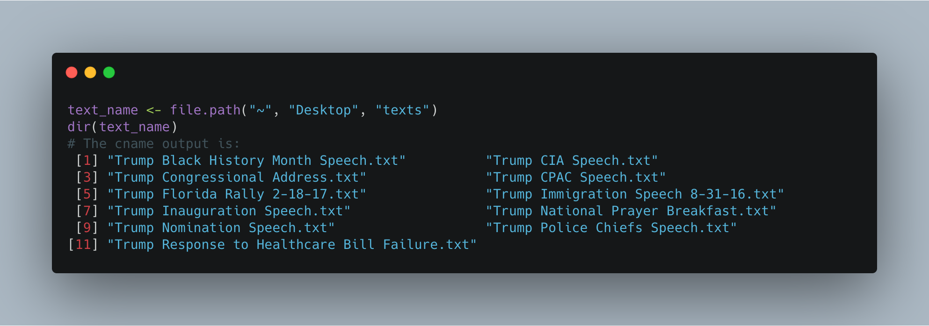
Loading Texts
Notes:
Start by saving the text files in a folder titled: “texts” This will be the “corpus” (body) of texts you are mining.

Slide 12
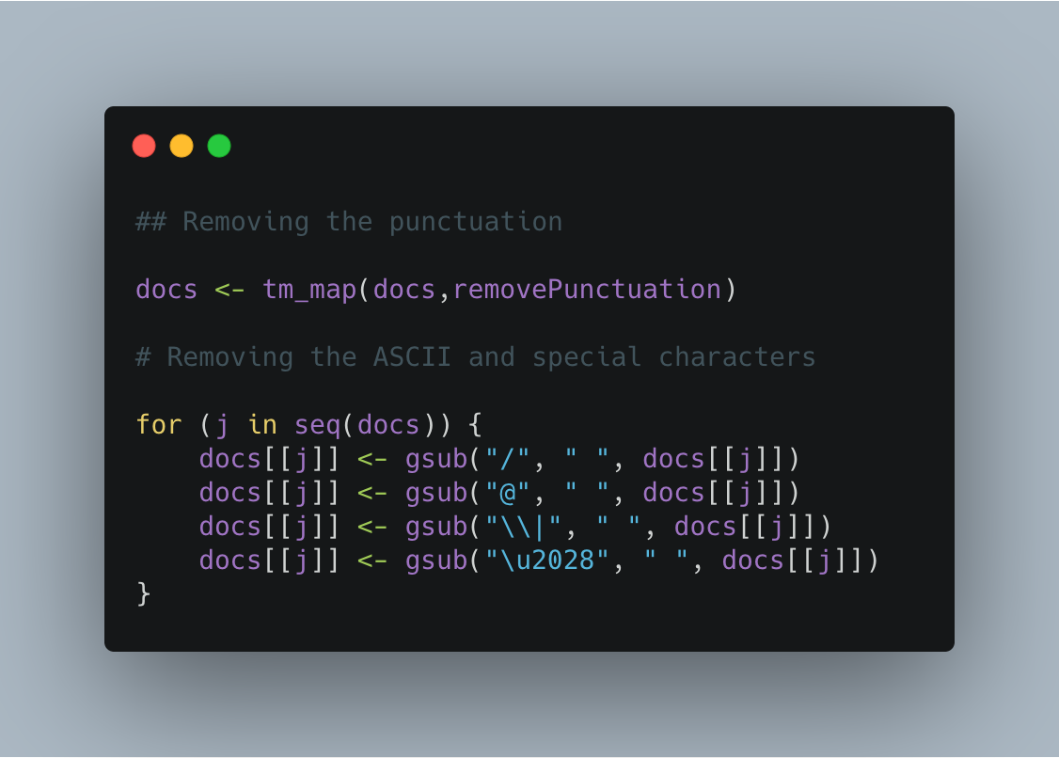
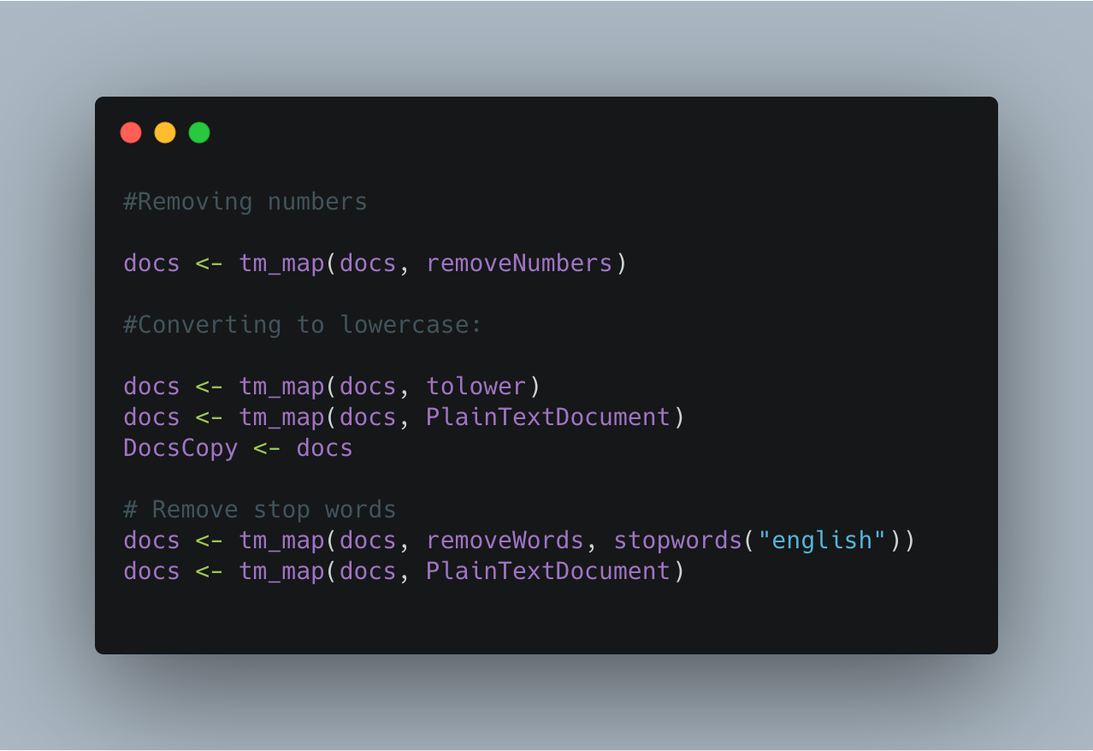
Removing Special characters, numbers, punctuation
Notes:
Cleaning up the data

Slide 13
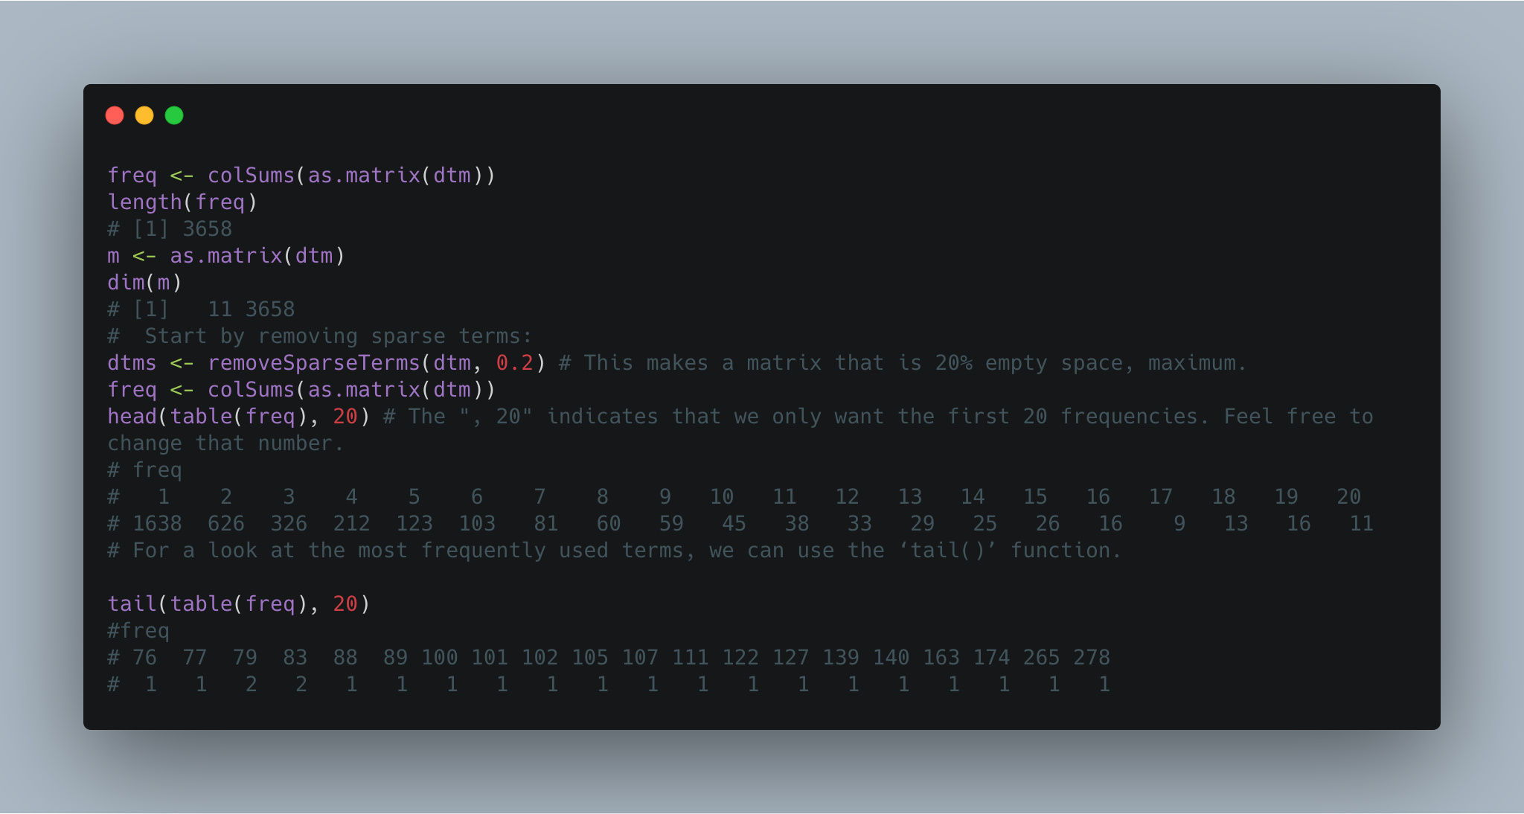
Explore Data
Notes:
Explore your data
Organize terms by their frequency and put them in the freq variable.
The resulting output is two rows of numbers.
The top number is the frequency with which words appear, and the bottom number reflects how many words appear that frequently. Here, considering only the 20 lowest word frequencies, we can see that 1602 terms appear only once. There are also a lot of others that appear very infrequently.

Slide 14
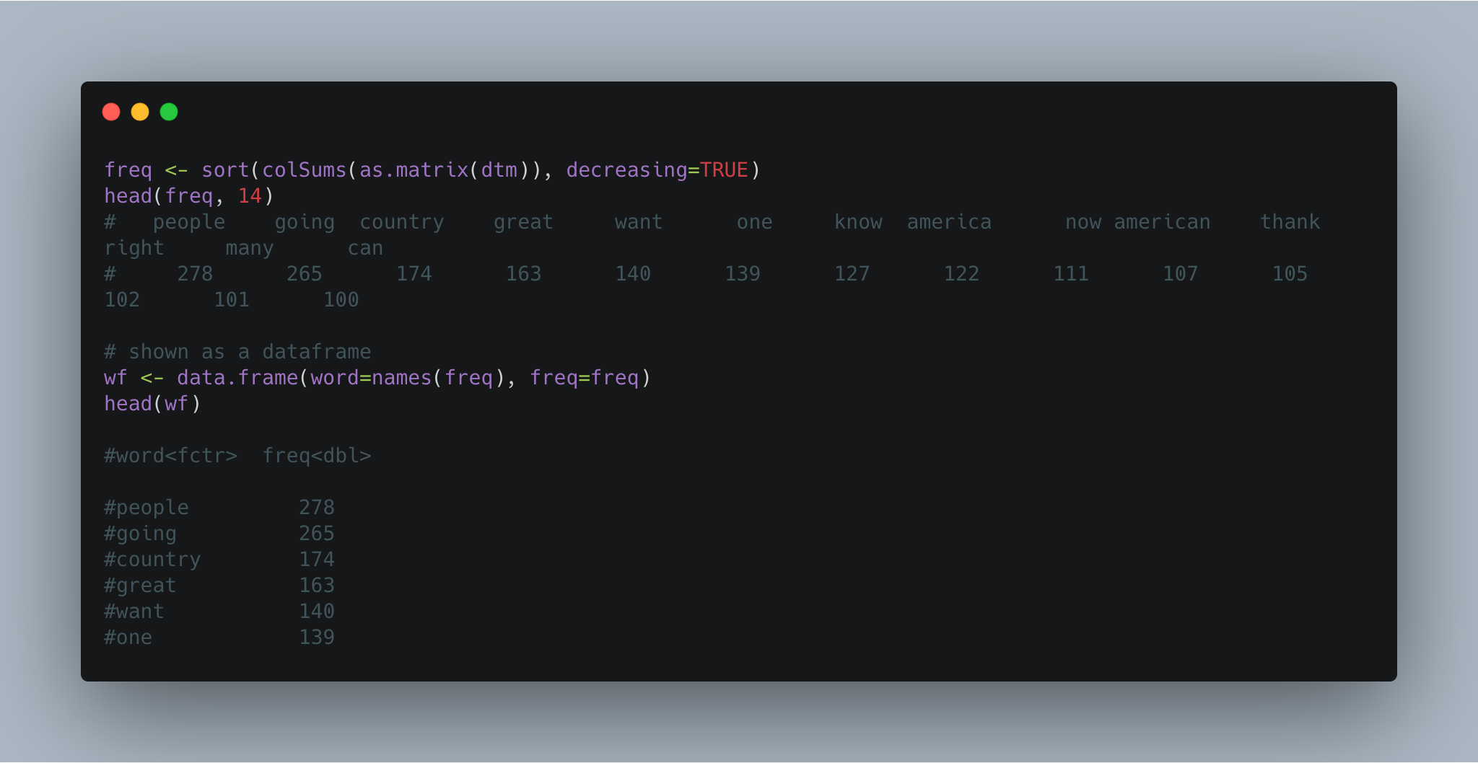
Showing frequencies as dataframe

Slide 15
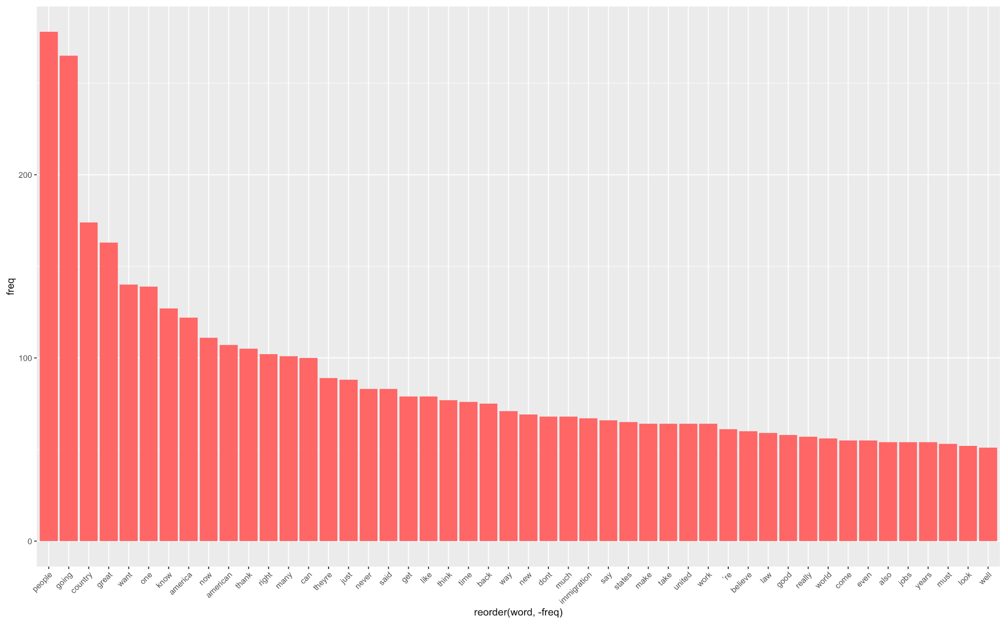
Word frequencies using ggplot

Slide 16
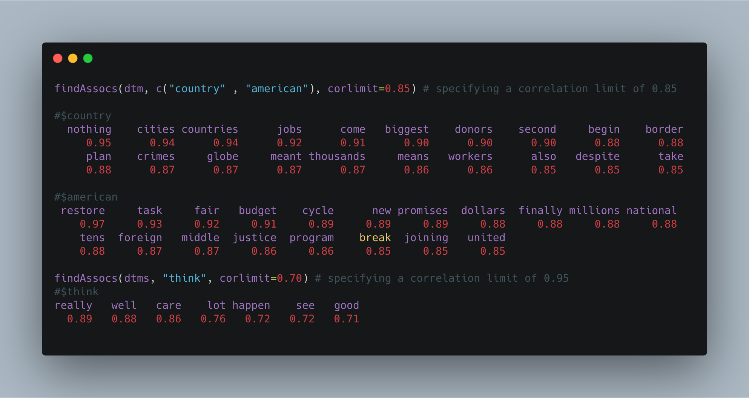
Correlation terms
Notes:
If you have a term in mind that you have found to be particularly meaningful to your analysis, then you may find it helpful to identify the words that most highly correlate with that term.
If words always appear together, then correlation=1.0.

Slide 17
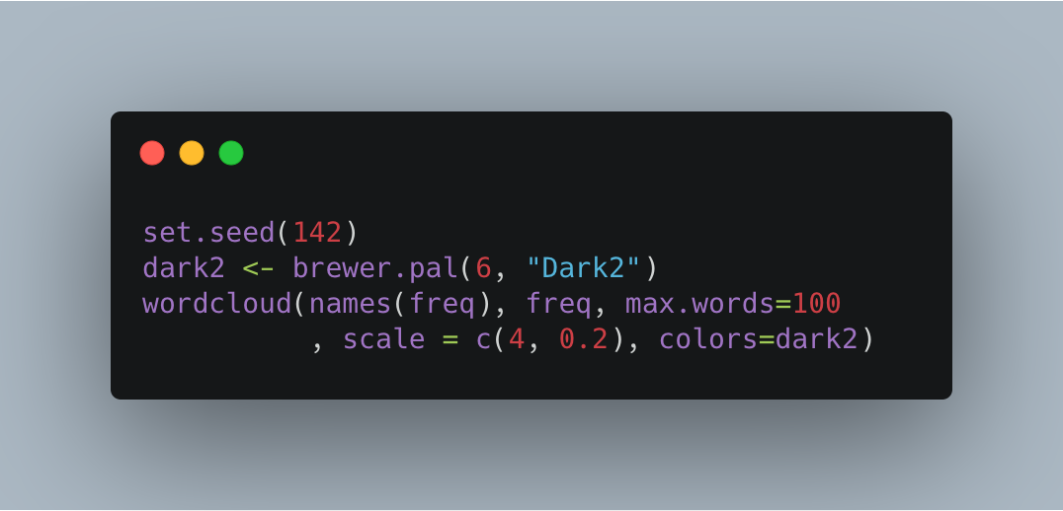
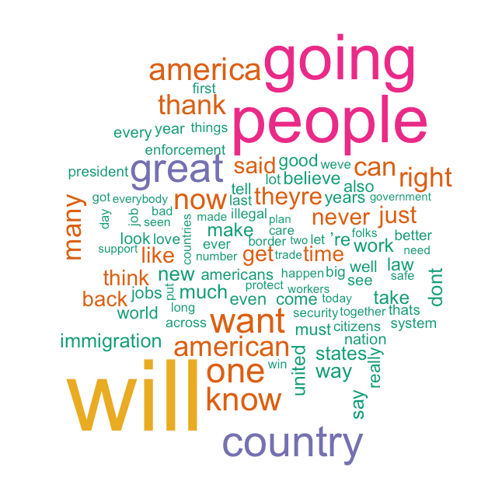
Word cloud
set.seed() function just makes the configuration of the layout of the clouds consistent each time you plot them.
Notes:
Humans are generally strong at visual analytics. That is part of the reason that these have become so popular. What follows are a variety of alternatives for constructing word clouds with your text.
But first you will need to load the package that makes word clouds in R.
The “set.seed() function just makes the configuration of the layout of the clouds consistent each time you plot them. You can omit that part if you are not concerned with preserving a particular layout.
So, here we plot the most 100 words used

Slide 18
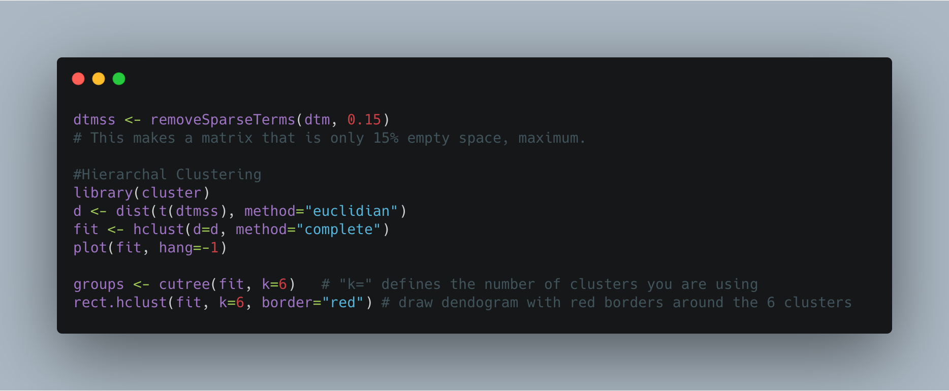
Clustering by Term Similarity

Slide 19
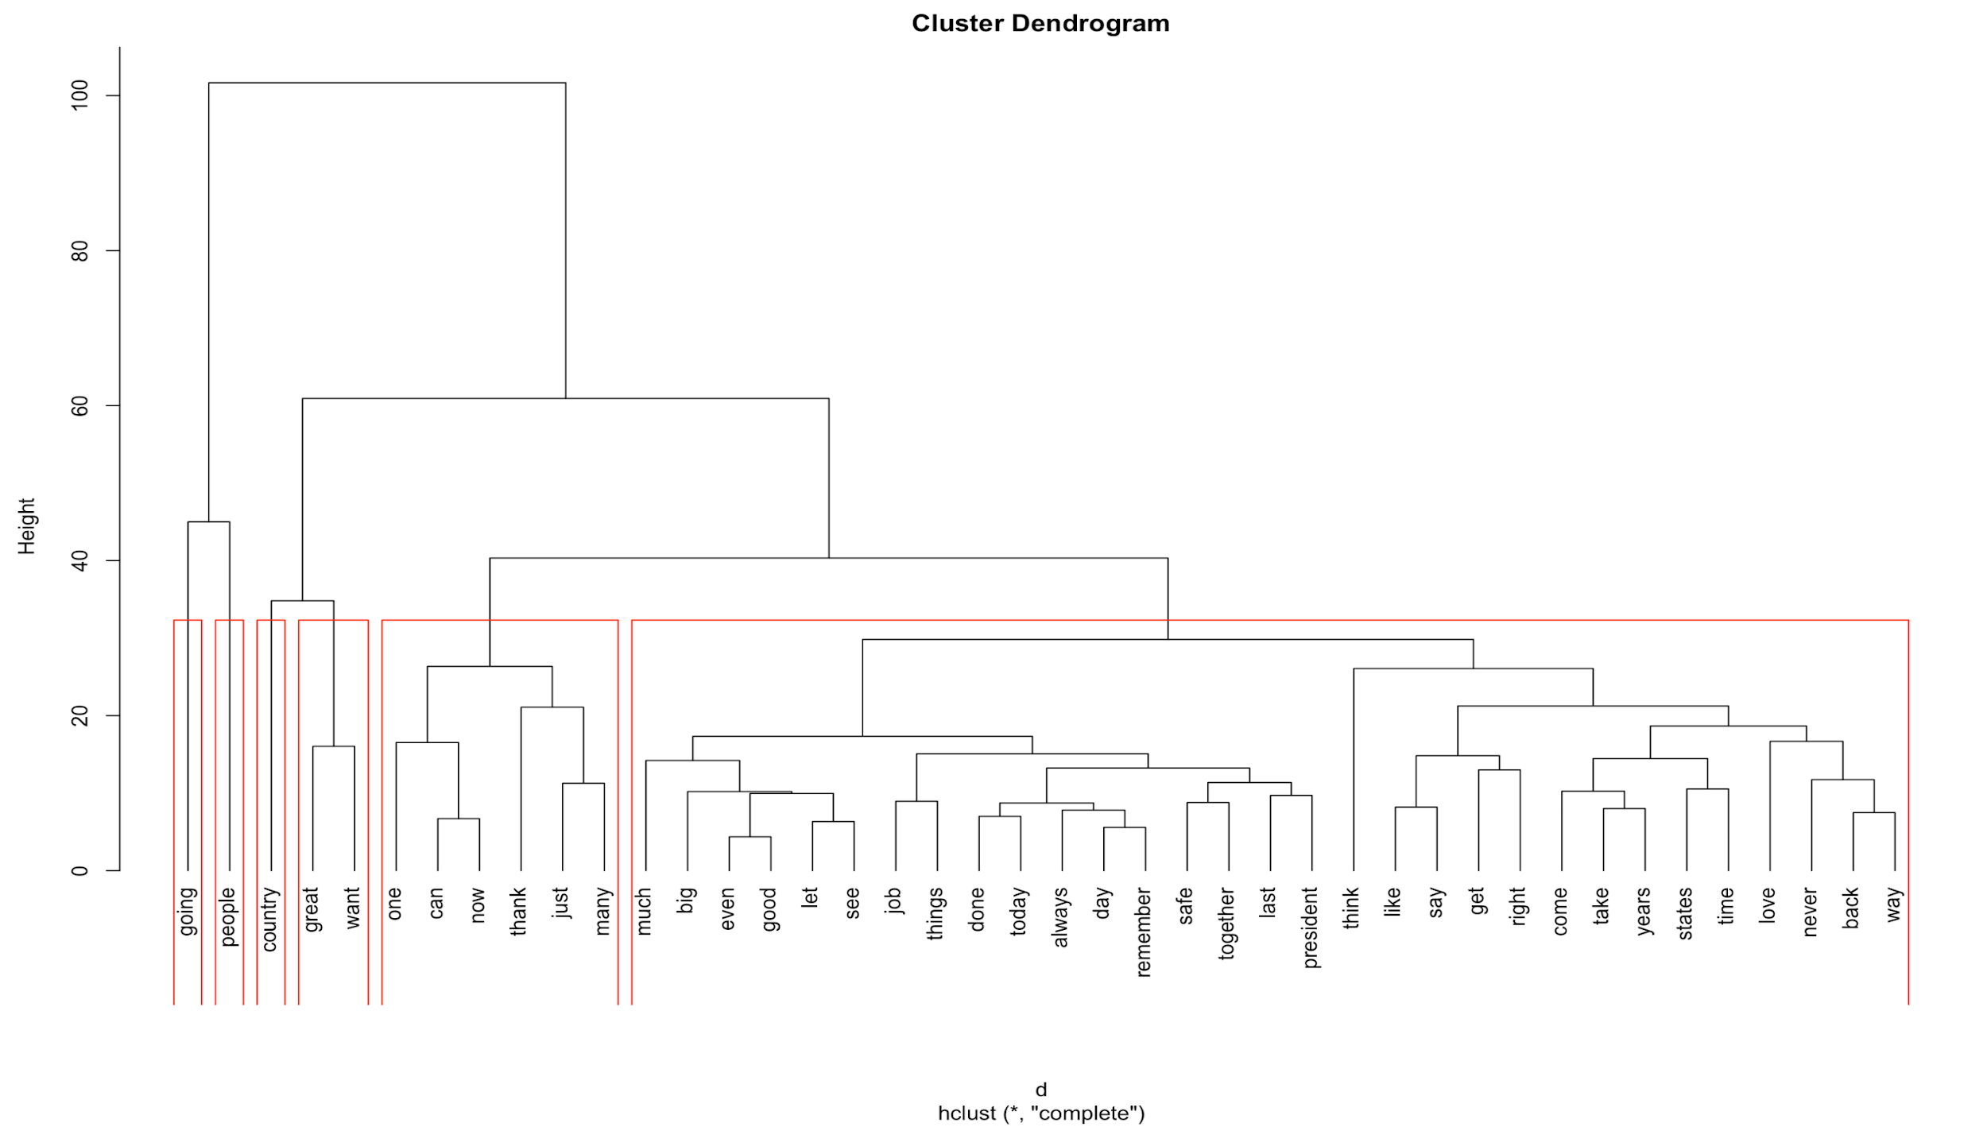
Cluster grouping - Dendrogram
Notes:
Some people find dendrograms to be fairly clear to read. Others simply find them perplexing. Here, we can see two, three, four, five, six, seven, or many more groups that are identifiable in the dendrogram.
Helping to Read a Dendrogram
If you find dendrograms difficult to read, then there is still hope.
To get a better idea of where the groups are in the dendrogram, you can also ask R to help identify the clusters. Here, I have arbitrarily chosen to look at five clusters (means k = 6) , as indicated by the red boxes. If you would like to highlight a different number of groups, then feel free to change the code accordingly.

Slide 20
Conclusion
“People”, “going” are the most common used words by President Trump. He used word “country”, “great” more frequently than “America” and “American” in his speeches.
Notes:
To Finalize this study, we have to do more work by analyzing other presidents’ speeches and comparing them with Trump speech to get more insight analysis.

Slide 21
Text Mining Softwares
Name | Avaliability | Website
rapidminer | Open-source | https://rapidminer.com/
Orange | Open-source | https://orange.biolab.si/
Weka | Free software | https://www.cs.waikato.ac.nz/ml/index.html
Qlik | Free for students and profs. | https://www.qlik.com/us/products/qlik-sense
Notes:
There are numerous data mining tools available in the market, but the choice of best one is not simple. A number of factors need to be considered before making an investment in any proprietary solution.
All the data mining systems process information in different ways from each other, hence the decision-making process becomes even more difficult. In order to help our users on this, we have listed market's top 15 data mining tools below that should be considered.
Qlik is a nice software, I just attended the Data Science conference organized by Katz university last week and they were there. They offer one year of free subscription all inclusive using the platform and training for graduate students and profs.

Slide 22
Text analysis is the automated process of obtaining information from text. SO BE CAREFUL!

Slide 23

Thanks!
Questions

